Slide 1

Site Reliability Engineering (SRE) Capabilities

Slide 2





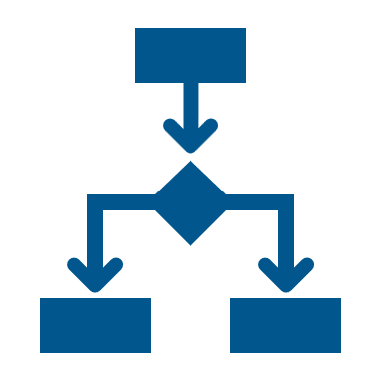
Site Reliability Engineering : Challenges & Impact
Impact
Absence of E2E single observability platform and historical data
Root cause detection tends as a time-intensive process
Degraded customer experience
Inconsistent tools and automation strategy leads to high toil, inefficient tool utilization
Higher spend on monitoring tools
Reactive approach rather than a Proactive approach
Challenges
Lack of visibility for business to plan
changes and features
Support team on firefighting mode
Inefficient skillset and limited time to implement automation and reduce toil
Lower than expected Resiliency and
Scalability for applications
© 2025 NTT DATA, Inc.
Notes:
Not needed
Traditionally, monitoring has happened manually and in silos paired with a lack of end-to-end approach. For example, an incidents comes up and is being raised in ServiceNow, post which the personnel doesn’t know which component to look at, thus looks at all the components. SRE bridges this gap by providing an e2e value stream led view.
By adopting an SRE mindset in the long run, the number of incidents can be optimized by leveraging AIOps and Self Healing.
SRE is a framework, it was launched by google in 2019
It aims at creating E2E Value Stream Led View
Traditionally – ITSM driven
SRE is engineering led, focus on E2E Value Stream mapping
Example Payments – which all apps are getting impact, SLI/SLO/Error Budget…how are systems are reading telemetry, how are they being collected, analysed, presented
Challenges
Lack of SPoG platform….Historical Data Correlation is missing
Root Cause is missing
Inconsistent tools- Splunk, Dynatrace, who owns these apps, who own the automation strategy
More reactive support than proactive support, lack of monitoring topology
Inefficient skill set
Degraded customer experience

Slide 3




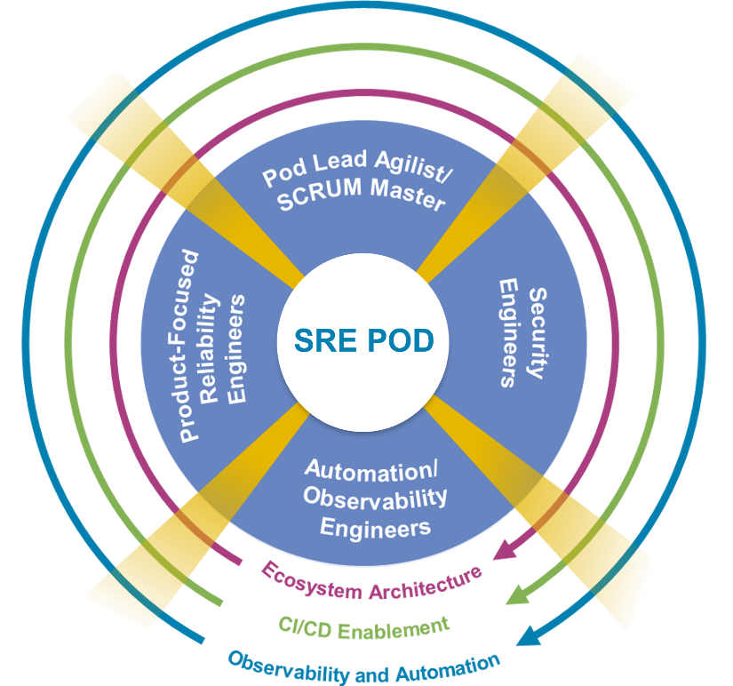
NTT DATA’s Approach to Transformation
Approach is to transform SRE operations through short-term, long-term initiatives and roadmap to have a target state where SRE is provided as a Service to bank consumers like business value streams and engineering.
Nascent State
Transformation State
Target State
Continuous improvement of SLI/SLO
SRE-as-a-Service with Continuous Improvement
Data silos
Manual repeated
task
Undefined
thresholds
SLI/SLO/SLA
Automation
Meaningful dashboards
Monitoring Tools
Enterprise Observability Automation
Feedback on SLO/SLI
Continuous improvement of AIOps
AIOps
AIOps platform for SRE Operations
Feedback on AIOps
Reactive
Proactive
Predictive
Enterprising
Notes:
Vikram
NTT DATA has a strong SRE practice supporting resiliency for organizations.
We follow a tool-agnostic approach and can help the organization in achieving the Target Operating Model where data is collated from all monitoring sources to be used in Dashboards and AIOps.
We help organizations transform SRE operations through short-term, long-term initiatives and a roadmap to have a target state where SRE is provided as a service to bank consumers like business value streams and engineering.
Defining and curating customized dashboards related to SLOs and Error Budgets.
We have been supporting various banks globally in the geographies of Europe, Ireland and US.
NTT DATA’s Splunk Capabilities are being powered by our Splunk Centre of Excellence (CoE). We have a robust CoE orchestrated by our strong competency, experience, global best practices, domain and business knowledge, value added services.
Our resources possess Splunk Expertise to deliver success:
NTT DATA Splunk SMEs have been a part of SplunkTrust since the year 2020, which is a Global community where Splunk recognizes a handful of individuals annually.
We possess relevant experience and capabilities to navigate through Splunk’s three operational towers: Architecture, Administration and ITSI (IT Service Intelligence)

Slide 4
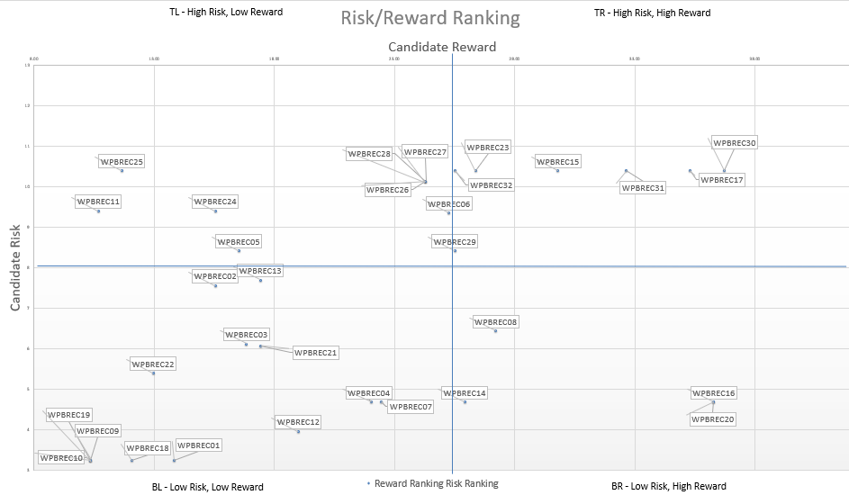

NTT DATA’s SRE Accelerators
Risk – Reward Matrix
Baseline SRE Metrics
SLI, SLO and Error Budget are crucial components of SRE. They help quantify the performance and reliability of services and set expectations for users and stakeholders. We have defined templates for the metrics (VALET) that can be used for a quick baseline setup.
V=Volume;
A=Availability;
L=Latency;
E=Errors;
T=Tickets
Accelerators
Quick Win Automations
SPoG & Integration
Splunk Configuration Changes
Pipeline that can be integrated to enable a configuration-as-code approach for managing Splunk settings. This streamlines the process of updating and maintaining Splunk configurations.
Certificate Renewal –
Microservice that automates the renewal of certificates hosted on Venafi. The service ensures the timely renewal of certificates and automatically pushes updated certificates to the relevant application repositories.
Single Plane of Glass
Comprehensive observability strategy is necessary for effective SRE. We have predefined dashboards in Grafana (an open-source tool) for SRE that can be reused by importing JSON files
Integration Scripts
We have developed tool-agnostic Python scripts that facilitate connections to various sources, such as Splunk, AppDynamics, InfluxDB, and more, enabling the retrieval of key application performance metrics and data transmission to databases.
Notes:
Vikram
NTT DATA has an array of accelerators such as:
- Defined templates for Error Budgets and SLIs/SLOs
- Reusable predefined dashboard
- Tool agnostic Python scripts

Slide 5


Engagement Overview 1
ACS SRE API Estate Assessment
Unified Observability Platform and Automations
NTT DATA was engaged with WPB ACS SRE in June 2022 to review their function capability, gaps and current processes.
We also assisted in developing a strategy along with an implementation roadmap to help establish an efficient SRE function.
Assessment of API alert estate and provision of remediation recommendations.
Presented POC to reduce toils like Automating restart Runbook, certificate renewal
Provided industry standards for various process
Developed a risk-reward matrix
NTT DATA was engaged in December 2022 for exploring Grafana as single pane of glass for ACS SRE team.
In Grafana, we will define SRE dashboards that will give a holistic real-time view of the IT estate’s (API’s microservices and underlying infrastructure) performance.
The dashboards provide the SLIs/SLOs/Error Budget and mapping between APIs, value stream and customer journey, helping identify hotspots in near real-time and prioritize according to error budgets.
Created foundation architecture for unified observability platform
Created data model
Defined SLIs/SLOs/Error Budgets for APIs
Dashboard in Grafana and Splunk ITSI
Expanded the POC for IT controls
© 2025 NTT DATA, Inc.
Notes:
Vikram

Slide 6



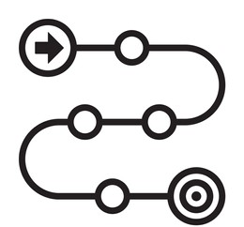
Engagement Overview 2
Background
Bank’s Payments Department operates across the globe to ensure 24*7 uptime and availability of payments applications & infrastructure ecosystem. Owing to the critical nature of payments operation, bank wants to develop a cohesive Tooling and Automation Strategy
Problem Statement
High MTTR & Absence of Real-Time View of incidents’ cause and impact
Need for a Cohesive Automation Roadmap
Slow pace of client impact assessment
0
1
2
3
4
5
6
7
8
9
10
11
12
13
NTTD’s Approach: Current State Assessment
Week
14
15 – 20
Scope: 5 Tier 0 Applications
Pre- onboarding activities
Onboarding Activities
Business Assurance
ITSM Processes
Change Management
Incident Trends & Analysis
Knowledge Mgmt.
Tools & Automation Strategy
Review of implemented tools
Assessment of overall automation strategy
Monitoring & Alerting
Review of alerting configurations
Capability assessment for trend analytics
Current State Assessment
Gap Analysis and Roadmap
Roadmap Submission
Proof Of Value
26th Jul
Mid of Dec’23
Ways of Working
Operational Structure for automation team
Available and required skills
Outcome: Actionable Roadmap that is extrapolated for all Tier 0 Applications to ensure
NTTD’s Approach : Gap Assessment
Standardised tooling, defined alerting & monitoring frameworks to enable E2E real-time view
Automation Strategy for Toil Reduction, Self-Healing & Predictive Analytics
Target Operating Model to operationalise sustainable automation
Inculcate SRE culture & mindset starting with Automation CoE
Compared: Current state of SRE Maturity at Bank’s Payments Department with that of other banks and Industry Standards
© 2025 NTT DATA, Inc.
Notes:
Sharang
Too many alerts
Tune max tools, get max efficiency
Payment story- brief- consulting assessment – Splunk, AppD followed by Data Correlation
Knowledge Management – Manage People dependency – Gen AI tool in Citi – give info based on incidents
Tugo
Knowler
Can we

Slide 7

Current State Assessment & Gap Analysis 1/2
Findings are on basis of detailed workshops, documents walkthrough and discussions with Bank’s Stakeholders for Five Tier 0 applications
Based on current marketplace analysis & NTTD’s experience with other FIs
Current State Assessment
Gaps Identified
Essential Monitoring
Advanced Monitoring
Proactive Monitoring
App & Infra monitoring not available
Tools deployed for active monitoring and defined thresholds
Monitoring tools integrated with ITSM tools and alerts are auto generated with correlated data
Application and Infra Monitoring in place for all applications
Splunk onboarding in progress to standardise monitoring for Tier 0 Apps
Multiple tools resulting in unrealized potential and inconsistent views
Monitoring data not associated with incident resulting in slower initial analysis
Monitoring Capability
Event Predictability
Unavailability of correlated data
Methodical through partial data analytics
Trend analysis and prediction
Alerting & Monitoring
Tracks application health & follows defined processes for failure paths
Business impact awareness of technical failures and failure paths documented
Continuous improvement & refined by auto feedback mechanisms
Service Quality and Failure Paths
Centrally defined
processes & procedures
Defined Service management and available metrics measurement framework
Efficient SOPs with traceability via monitoring tools and focus on MTTR and MTBF
SME knowledge and resulting in highly stable app ecosystem with availability of 99.9982 %
Clearly defined and managed Major Incident Management (MIM) processes
Enterprise guided impact assessment matrix, resulting in an unclear priority order
Scope to enhance problem management function, making it centralized and more payments centric
Incident Management
Centrally defined
processes & procedures and MIM process for high severity incidents
Recurring Incident analysis and effective SOPs to drive RCAs for incidents of all severity
Root cause fix linked to automation initiatives
Business Assurance –
Incident, Change & Problem Management Processes
Problem Management
Incident severity and priority not guided by business-driven parameters
Impact assessment matrix driven by business imperatives
Automated tagging and SLA measurements by impact assessment
Incident Impact Assessment
© 2025 NTT DATA, Inc.
Client Bank
Industry Standard
Best in Class
Notes:
Sharang

Slide 8
Current State Assessment & Gap Analysis 2/2
Findings are on basis of detailed workshops, documents walkthrough and discussions with Bank’s Stakeholders for Five Tier 0 applications
Based on current marketplace analysis & NTTD’s experience with other FIs
Current State Assessment
Gaps Identified
Essential Monitoring
Advanced Monitoring
Proactive Monitoring
Automation initiatives driven by support groups at regional level
Backlog of work for Toil reduction is maintained in JIRA
A coherent GPS strategy and a framework to measure & realize automation ROI is not evident
Need of dedicated capacity with required skills
Self CHOP* Capabilities
Automation initiatives are non-existent and high toil
Strategized, Planned & Supported at Application or Regional level
Strategized, Planned & Fully Supported at global level with detailed ROI measures
Automation Strategy & Initiatives
*Self CHOP: Self configuring, healing, optimizing and provisioning
Historical trend analysis & future predictions
Readily available historical data
Analyzing historical trends and alerts
Automating based on trends to avoid manual tasks
Dashboards
No defined dashboards
Siloed, available at application or regional level
E2E visibility with defined application health thresholds
Dashboards available at individual application levels
Application health checks available but can be uplifted
Absence of E2E monitoring and “single-pane-of-glass” view of applications at business and engineering levels
Historical and future trend analysis not possible due to lack of historical data from monitoring tools
Partial Awareness &
not implemented
Partially Captured but not aligned to business objectives
Fully Captured & Documented, aligned with Business definitions
SLI, SLO and Error Budget
Real time view of application health
E2E Monitoring & Business Outcome Visibility
Inadequate Monitoring & lacks business correlation
Adequate Monitoring & defined measures for business outcomes
Full monitoring with Trend Analysis, Prediction and business view
Awareness of SRE Practices
Defined SRE metrics and monitoring indexes
Mature SRE practice with Product, IT, Operations view across customer journeys
SRE inspired ways of working
© 2025 NTT DATA, Inc.
Client Bank
Industry Standard
Best in Class
Notes:
Achieve Faster TRMF Compliance – add this point

Slide 9
















Current vs Target State Architecture
Current State Architecture has been derived for five applications (GPE, WOLF, PDP, POL and GMG) based on detailed analysis. Considering these 5 apps as a true sample, target state Architecture is curated for all GPS applications bearing in mind they will have similar tech stack and monitoring
App 1
App 2
App 3
App 4
App 5
Infra Layer
VM
VM
VM
Non-IKP Apps
IKP Apps
Apps Layer
C++
Microservices
Current State
Target State
What is Changing?
Challenges with Patrol
IKP Apps
Non-IKP
IKP Apps
Non-IKP
❶
Historical data not available for trend analysis
CICD workflow can’t be associated, no drift prevention
Fetching & review of alert parameters is cumbersome
No capability for data sharing from AppD
No dashboard capability
Process
Process monitoring to be switched from Patrol to AppDynamics
Log monitoring to be switched from Patrol to Splunk
One dashboard tool (Splunk ITSI) for all applications with consolidated data from all monitoring tools.
Automation use cases to be implemented with improved tool utilisation, xMatters to be leveraged for self-healing.
❶
Log
❷
❷
Monitoring Layer
❸
Infra
Dashboards
Service Health
User/ Persona Layers
❹
App 1
AppD Dashboard
Operations
Engineering
Support
❸
Log Watcher Tool
SPLUNK ITSI
IDRS – DC monitoring
Unified Dashboards
2024
After 2024
App 2
Monitoring setup in Splunk/AppD for Tier 0 services
Post approval from ITSOs and App owners, incident creation in SNOW will be migrated to Splunk/AppD from PATROL
Incident Generation via SNOW through Splunk/AppD
Post Splunk/AppD alerting approvals for working & coverage, PATROL alert monitoring to be switched off
App 3
IKP - Grafana
Central Reference Data
In-house Tools
❹
Automation
Alert setup continues in PATROL
© 2025 NTT DATA, Inc.
Notes:
Sharang + Vikram

Slide 10
Key Challenges, Proposed Solution & Expected Benefits
Key Challenges
Alerting & Monitoring
Time to Resolve
Automation Strategy & Initiatives
Real-time View
Ways Of Working
Inconsistent views across apps due to unstandardised monitoring config. & multiple tools.
Slower incident analysis due to lack of data correlation between tools and applications
Siloed automation initiatives driven by support groups at regional level with a lack of coherent GPS strategy
Absence of E2E monitoring and SPoG view of apps
Lack of framework to manage, measure ROI & implement automation.
No event predictability & trend analysis due to unavailability of historical & consolidated alerts data
1
2
3
4
5
1
2
3
4
5
1
2
3
4
5
1
2
3
4
5
1
2
3
4
5
Solution Tenets
1
Standardization of Monitoring Tools
3
Designing of Service Catalogue
4
5
Set up Operating Model
2
Define Key Metrics
Implementation of Automation Use-Cases
To operationalize automation, upskill, cross skill and train resources in tools and technology
Set up standardized frameworks in Splunk & AppD
A core document connecting Region-> Payment Flow-> Application -> Components
Determine thresholds to gauge the component & app health
Defined processes to generate book of work and qualify for ROI
Expected Benefits in 2025
Resilience
Efficiency
Speed of work
Scale
CX Improvement
Reduced risk through reduction of ~550 TPAM requests. Faster identification of hotspots and prioritized resolution will improve uptime.
~20% MTTR Reduction and leveraging Gen AI for KM. Access to alert data through correlation of tools integrated with incidents
~$500k of effort through freeing up of 5.05 FTE time because of reduction in 1265 incidents & TPAM requests due to automation of routine/repeat tasks.
Reduced outage due to preventative failure because of predictions from historical data, and better/faster customer impact identification
~25% Faster time to market as we move away from being reactive to being proactive
© 2025 NTT DATA, Inc.
Notes:
Sharang + Vikram

Slide 11
Risk Impact Ranking with Benefit(s) Mapping
Risk Impact matrix framework is developed by NTT to identify and prioritize implementation of initiatives in roadmap inline with required actions
High
Timeline to implement
Q1
Q4
Splunk Alerting
Q2
Q3
Feature Toggle
06
Automation for Space Exhaustion
26
20
Role swap / DR Automation
Initiatives outside of this program to be addressed by Bank’s Payments team in parallel
PUBSUB topic handling
Config drift for Infrastructure
Monitoring Tools Drift Prevention
Service Catalogue
Operating Model
11
28
02
Avoid Alert testing in Prod
GPSSG4_BP_M04 Job failure
01
09
Backout Queue cleaning
27
Risk
App Dynamics Uplifting
24
22
Auto VM/POD restart
21
Problem Management
12
Patrol Migration
04
23
07
14
08
05
03
Benefits
Sequence Gap in CHIPS
15
Avoid Debug logs ingestion
13
17
18
Control-M Housekeeping
Speed of Work
16
Knowledge Management
29
25
10
Impact Assessment Matrix creation
19
CICD for Splunk
Scale
Alert housekeeping in Splunk
Analytics in AppD
KM Uplifting using Gen AI
Resilience
Alert suppression in AppD
Splunk URL in xMatters emails
Define Baseline Metrics for SRE
Auto Cert renewal
Efficiency
Stability
High
Volume Reduction
Low
Impact
Notes:
Sharang + Vikram

Slide 12
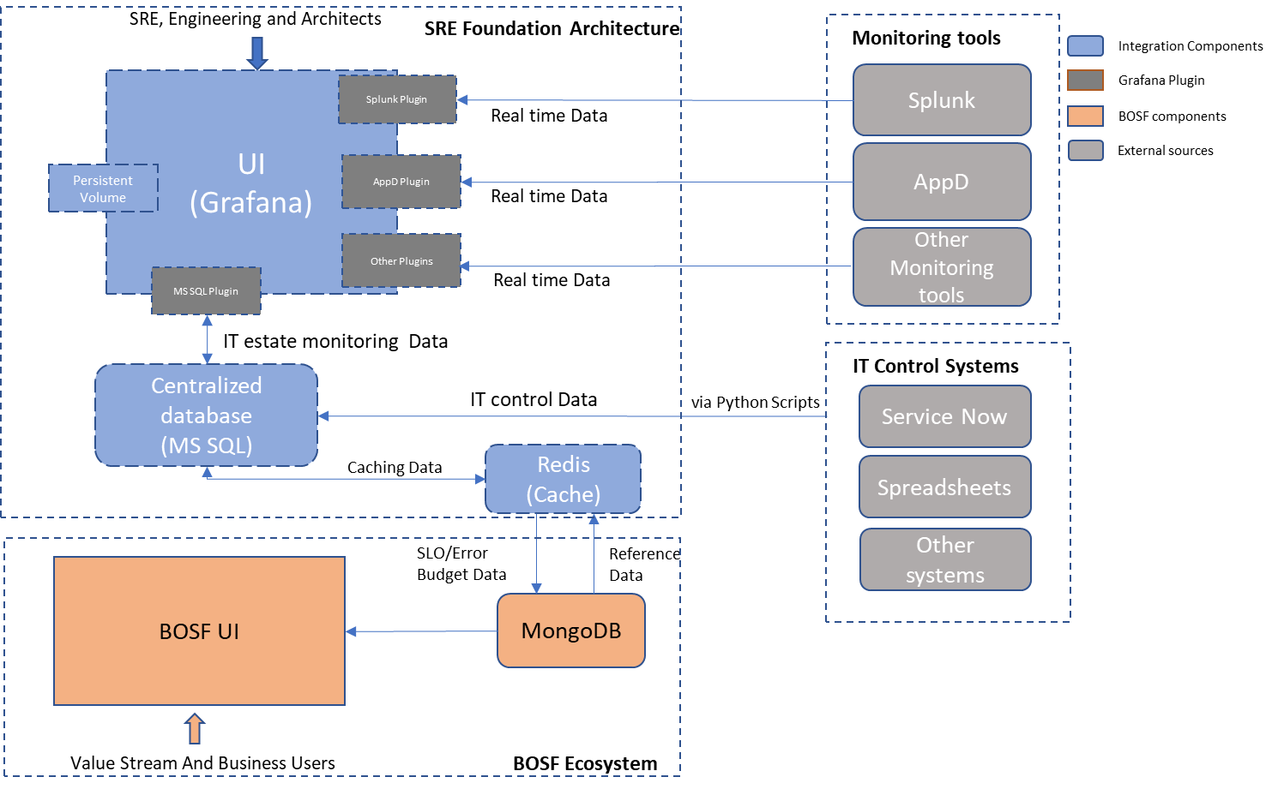
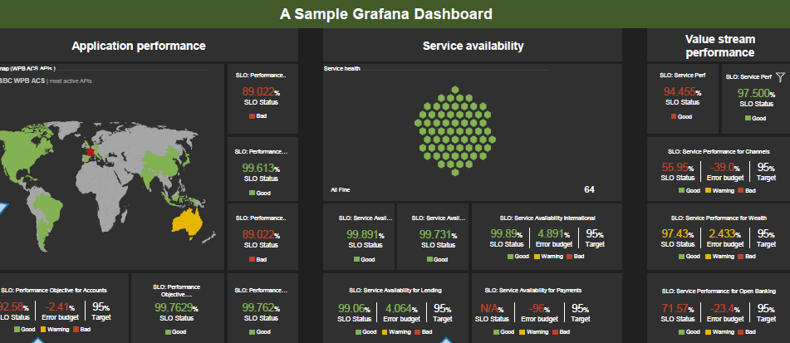
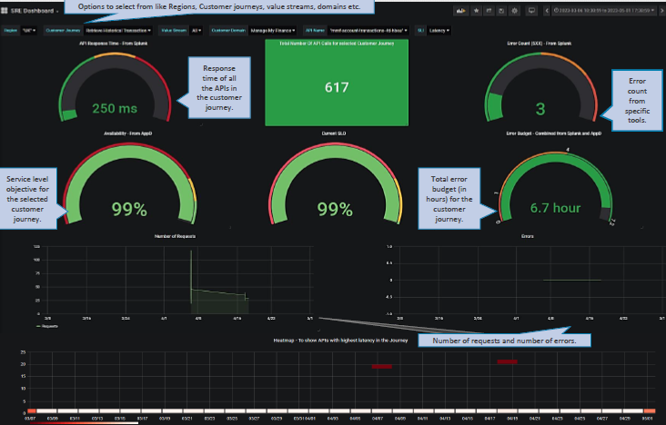
Illustration - End State Architecture & Near Real-Time Dashboards
© 2025 NTT DATA, Inc.
Notes:
Sharang + Vikram

Slide 13
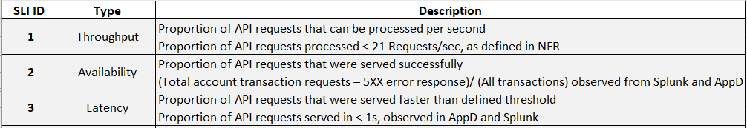
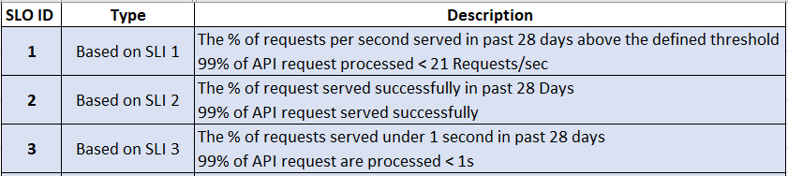
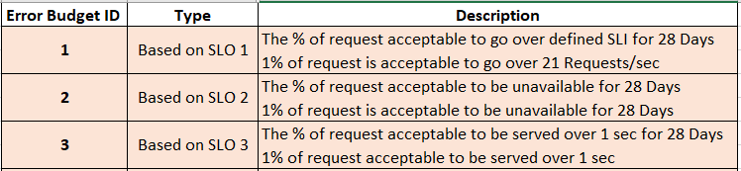
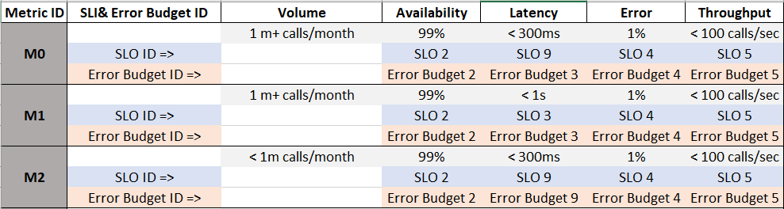
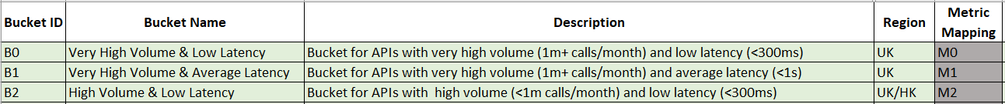
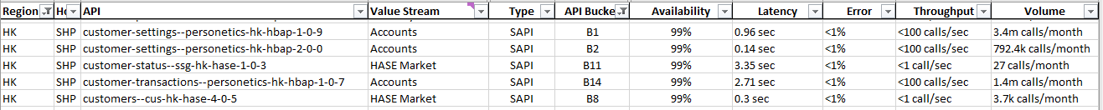
API Buckets
1. Define SLIs
2. Define SLOs
3. Define Error Budgets
5. Define Buckets
4. Define Metrics
6. Mapping API to Bucket
© 2025 NTT DATA, Inc.
Notes:
Vikram

Slide 14
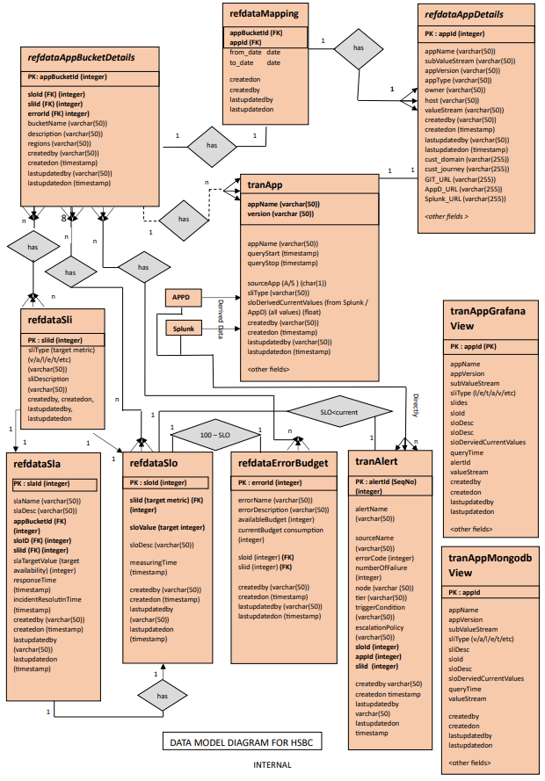
Data Model
© 2025 NTT DATA, Inc.
Notes:
Sharang + Vikram

Slide 15
Industry Standard Metrics for Measuring the Effectiveness of an entire IT Estate
Business Channel
Average lead time (ALT) | Work-in-progress (WIP) | Percentage change user volume (CUV) | Average process time (APT) | Average wait time (AWT) | Mean time to restore (MTTR)
Development Channel
Test coverage percentage (TCP) | API reuse rate (ARR) | API consumption rate (ACR) | Build failure frequency (BFF) | Rework rate (RR) | Commit to prod deployment latency time
Build duration (BD) | Build frequency (BF) | Defects volume (DV) | Code analysis defects (CAD) | Commit frequency (CF) | Number of story points
Average failed deployment rate (FDR)* | Number of deployments/day (DPD)* | Percentage failed deployment | Average failed release rate (FRR) | Number of releases/day (RPD) | Percent failed release
Operations Channel
Automated detection rate (ADR) | Average build failure frequency (ABFF) | Average cycle time (ACT) | Average change volume (ACV) | Daily change rate (DCR) | Defect burndown ratio (Open/Closed)
Open by technology (OBT) | Mean time to detect (MTTD) | Mean time to diagnose | Mean time to resolution (MTTR) | Mean time between failure (MTBF) | Average response time
Availability | Raw downtime minutes | Mean time between incidents (MTBI) | Average number of open incidents/day | Average number total incidents/day (IPD) | Average number of incidents close/day
IaC request to deployment average latency time | Percentage IaC latency threshold achieved | Percentage CaC requests to deployment latency time | Percentage CaC latency threshold achieved
Security Channel
Number of unpatched known vulnerabilities | Frequency which employee access reassessed | Percentage of cyber resources properly configured | Average time to Patch | Average time from patch release to patch installation | Percentage of the critical incident where pre-planned responses exist
Percentage of vulnerabilities checked for compliance | Average time to mitigate known vulnerability
Reliability
Four channels:
Business Channel
Development Channel
Operations Channel
Security Channel
Widely used Metrics
Other Metrics
Metrics Management Approach
Engage Phase: Identify and establish a metrics strategy
Execute Phase: Data collection and baselining of threshold
Evolve Phase: SLA tracking and reporting, re-baseline through change management
© 2025 NTT DATA, Inc.
Notes:
Sharang + Vikram

Slide 17


Observability Dashboards in Grafana
Define and implement the dashboard related to SLO and Error Budgets
A Sample Grafana Dashboard
Application performance |  |  |  | Service availability |  |  |  | Value stream performance
Worldmap (WPB ACS APIs )
SLO: Performance..
Service health
SLO: Service Perf
SLO: Service Perf
Bank WPB ACS | most active APIs
89.022%
SLO Status
94.455%
SLO Status
97.500%
SLO Status
Bad
Good
Good
SLO: Performance…
SLO: Service Performance for Channels
A global view of the most active Application
99.613%
SLO Status
55.95%
SLO Status
-39.0%
Error budget
95%
Target
Good
All Fine
64
Good
Warning
Bad
SLO: Performance..
SLO: Service Avail…
SLO: Service Avail…
SLO: Service Availability International
SLO: Service Performance for Wealth
89.022%
SLO Status
99.891%
SLO Status
99.731%
SLO Status
99.89%
SLO Status
4.891%
Error budget
95%
Target
97.43%
SLO Status
2.433%
Error budget
95%
Target
Bad
Good
Good
Good
Warning
Bad
Good
Warning
Bad
SLO: Performance Objective for Accounts
SLO: Performance Objective….
SLO: Performance…
SLO: Service Availability for Lending
SLO: Service Availability for Payments
SLO: Service Performance for Open Banking
92.58%
SLO Status
-2.41%
Error budget
95%
Target
99.7629%
SLO Status
99.762%
SLO Status
99.06%
SLO Status
4.064%
Error budget
95%
Target
N/A%
SLO Status
-96%
Error budget
95%
Target
71.57%
SLO Status
-23.4%
Error budget
95%
Target
Good
Warning
Bad
Good
Good
Good
Warning
Bad
Good
Warning
Bad
Good
Warning
Bad
Represents the defined SLO for a value stream
Represents the Error Budget left before it can impact the service
The error budget dashboard will help PM and team in identifying whether the API needs some attention like fixing it (depleted error budget) or it can handle more frequent feature releases
The SLO dashboard will help SRE in identifying, whether the API has a high impact (for example, an SLO of 99.999) and alert/incident related to it, is of the highest priority and need to fix it first
© 2025 NTT DATA, Inc.
Notes:
Sharang + Vikram

Slide 18


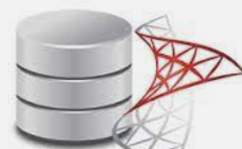

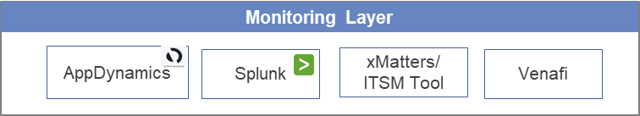





Target State: Tools, Automation & E2E observability
Current State
Target State
Efficient Tools Configuration & Monitoring
Correlation of Data
InfluxDB
MongoDB
MSSQL
Centralised DB
Data collated from all the monitoring sources to use in Dashboards and AIOps
End to End Observability
Bespoke Automation
Data Analytics
Overarching AIOps
Infra Layer
App Layer
Kubernetes
Monoliths
Single Pane of glass view
Runbooks Automation
Historical Trend Analytics
Cloud
Mainframe
Self Healing
User/ Persona Layer
Configuration as a Code
Future Projections
VM
Serverless
Predictive Maintenance
Defined SLI, SLO, Error budgets
Certificate Renewals
Failure Hotspots Identification
Bare metal
Microservices
Use Case n
Benefits for Bank
Reactive approach to Site Reliability Engineering
Inefficient implementation of monitoring tools
No single observability platform
Historical alerts & incident data not available as rich monitoring data not shared outside monitoring tools and is discarded within a few weeks.
Automation strategy non-existent. Most activities are manual
Improved End-to-End Customer Experience
Efficient use of monitoring tools
Easy retrievable data from centralized DB for audit trials, Risk and compliance
© 2025 NTT DATA, Inc.

